Slide 1
… Lecture 9 … Variances and Perspectives

Slide 2
… Lecture 9 … Variances and Perspectives
Part 1:
Comparing genetic variances: what is Vg?

Slide 3
Estimates of Heritability
We know what we mean by
e.g. h² = 0.5 for milk yield

Slide 4
Estimates of Heritability
We know what we mean by
e.g. h² = 0.5 for milk yield
Heritability varies across populations
e.g. breeds
… and across herds
… and within families
We have an idea it refers to ‘some’ population
which?
Are we sure?

Slide 5
Ancient History
Pre-REML
heritability estimated from selection experiments
variance of paternal half-sibs (PHS)
Sire Models!
important for good estimates in real populations
sires often selected before breeding
estimates are biased!
what are we estimating?

Slide 6
REML Age
Estimate of refers to the base population
remember QG definition cov(u_{i},u_{j}) = V_{A,0} a_{ij}
in the model it is MVN(0, V_{A}A)
i.e. the sub matrix of A which is identity matrix
but are they truly unrelated individuals!

Slide 7
REML Age
Estimate of refers to the base population
i.e. the sub matrix of A which is identity matrix
but are they truly unrelated individuals!
what base population?
Base
F
Base
Data
Data

Slide 8
REML Age
Estimate of refers to the base population
i.e. the sub matrix of A which is identity matrix
but are they truly unrelated individuals!
what base population?

Slide 9
REML Age
Estimate of refers to the base population
i.e. the sub matrix of A which is identity matrix
but are they truly unrelated individuals!
what base population?
Can change V_{A} by adding some ancestral pedigree!

Slide 10
Genomic Age
Van Raden G … estimates
genic variances - all loci in LE and in HWE
individuals used to construct G if markers in HWE
can you compare with
Change G … there are many!
e.g. prune a few SNPs
does estimate of refer to same population?
is h² same?

Slide 11
Genomic Age
Van Raden G … estimates
genic variances - all loci in LE and in HWE
individuals used to construct G if markers in HWE
can you compare with
Change G … there are many!
e.g. prune a few SNPs
does estimate of refer to same population?
is h² same?
Yet many papers compare h² from different A and different G - more sense to compare !

Slide 13
Perspectives
Specific populations and sub-populations of interest …
e.g.
all individuals with data
particular generations
selection candidates
Can compare different models:
accuracies
also predicted variances

Slide 14
General Result
For a population with (co)variance matrix V
can refer to a trait phenotype, breeding value, …
individuals have value y_{i}
v_{ii} = var(y_{i}) , v_{ij} = cov(y_{i},y_{j})
Variance within the population
=
a standard result for variances
=
See handout

Slide 15
General Result
Variance within the set =
= (3+2+4)/3 – (3+1-1+1… +4)/9
= 3 – 1
= 2

Slide 16
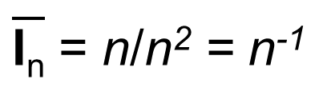
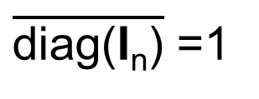
Apply to Relationships
A matrix
(co)variance of breeding values is
sub-matrix for base generation of size n is
so variance within the base is
as and
So the REML estimate of parameter is estimating variance for a very large base population from which n sampled
$\overline{\text{diag}\text{(}\text{I}\text{n}\text{)}}$ =1
$\overline{\text{I}\text{n}}$ = n/n² = n⁻¹

Slide 17
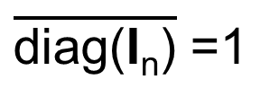
Apply to Relationships
A matrix
(co)variance of breeding values is
sub-matrix for base generation of size n is
so variance within the base is
as and
So the REML estimate of parameter is estimating variance for a very large base population from which n sampled
e.g. variance within this base is
$\overline{\text{diag}\text{(}\text{I}\text{n}\text{)}}$ =1
$\overline{\text{I}\text{n}}$ = n/n² = n⁻¹

Slide 18
Apply to Relationships
Van Raden G₁ or G₂
(co)variance of breeding values is
as sum of elements is 0
if all loci are in HWE …
so REML estimate is estimating genetic variance within set used to construct
see handout ‘properties of Van Raden matrices’

Slide 19
Apply to Relationships
G₁ matrix … Van Raden 1 for the base
0.27 | -0.42 | -0.42 | 0.22
-0.42 | 0.79 | 0.79 | -0.48
-0.42 | 0.79 | 0.79 | -0.48
0.22 | -0.48 | -0.48 | 0.80

Slide 20
Apply to Relationships
G₁ matrix … Van Raden 1 for the base
0.27 | -0.42 | -0.42 | 0.22
-0.42 | 0.79 | 0.79 | -0.48
-0.42 | 0.79 | 0.79 | -0.48
0.22 | -0.48 | -0.48 | 0.80
c.f. 0.75V_{A} !

Slide 21
Conclusion
Estimates of V_{A} & V_{G} from different relationship matrices not directly comparable!
Compare models by:
defining a subset of interest
e.g. whole population
e.g. genotyped individuals
estimate variance, estimate h² etc. on same subset for each relationship matrix

Slide 22
Comparing Genetic Variances
Define subset S … e.g. for A
find submatrix A[S]
take average of diagonal of A[S]
take average of all A[S]
find difference, say k
estimated variance within S is
s.e. ( ) is
can calculate h²[S]
e.g.
vpredict( my.asr, hh[S] ~ k*V1/(k*V1+V2) )

Slide 23
Comparing Genetic Variances
Define subset S … e.g. for A
find submatrix A[S]
take average of diagonal of A[S]
take average of all A[S]
find difference, say k
estimated variance within S is
s.e. is
can calculate h²[S]
e.g.
Strictly V2 should also be replaced by (1-n⁻¹)V₂ where n is size of S
vpredict( my.asr, hh[S] ~ k*V1/(k*V1+V2) )

Slide 25
Example
In table below V_{A} is the component, V is G₁, A, G_{FG}, or A₊
 | Analysis |  |  | Target Population
Matrix | V_{A} | s.e.(V_{A}) |  | V_{A} | s.e.(V_{A})
G₁
A
G_{FG}
A₊
G₁, A, G_{FG}
Pedigree has data and genotypes
A₊
Data and genotypes
as for G₁, A, G_{FG}
plus
additional pedigree

Slide 26
Example
In table below V_{A} is the component, V is G₁, A, G_{FG}, or A₊
 | Analysis |  |  | Target Population
Matrix | V_{A} | s.e.(V_{A}) |  | V_{A} | s.e.(V_{A})
G₁
A
G_{FG}
A₊
G₁, A, G_{FG}
Pedigree has data and genotypes
A₊
Data and genotypes
as for G₁, A, G_{FG}
plus
additional pedigree

Slide 27
Example
In table below V_{A} is the component, V is G₁, A, G_{FG}, or A₊
 | Analysis |  |  | Target Population
Matrix | V_{A} | s.e.(V_{A}) |  | V_{A} | s.e.(V_{A})
G₁ | 14.6 | 10.5 | 0.973 | 14.2 | 10.2
A
G_{FG}
A₊
G₁, A, G_{FG}
Pedigree has data and genotypes
A₊
Data and genotypes
as for G₁, A, G_{FG}
plus
additional pedigree

Slide 28
Example
In table below V_{A} is the component, V is G₁, A, G_{FG}, or A₊
 | Analysis |  |  | Target Population
Matrix | V_{A} | s.e.(V_{A}) |  | V_{A} | s.e.(V_{A})
G₁ | 14.6 | 10.5 | 0.973 | 14.2 | 10.2
A | 22.2 | 19.5 | 0.698 | 16.3 | 13.6
G_{FG}
A₊
G₁, A, G_{FG}
Pedigree has data and genotypes
A₊
Data and genotypes
as for G₁, A, G_{FG}
plus
additional pedigree

Slide 29
Example
In table below V_{A} is the component, V is G₁, A, G_{FG}, or A₊
 | Analysis |  |  | Target Population
Matrix | V_{A} | s.e.(V_{A}) |  | V_{A} | s.e.(V_{A})
G₁ | 14.6 | 10.5 | 0.973 | 14.2 | 10.2
A | 22.2 | 19.5 | 0.698 | 16.3 | 13.6
G_{FG} | 24.4 | 12.5 | 0.701 | 17.1 | 8.8
A₊
G₁, A, G_{FG}
Pedigree has data and genotypes
A₊
Data and genotypes
as for G₁, A, G_{FG}
plus
additional pedigree

Slide 30
Example
In table below V_{A} is the component, V is G₁, A, G_{FG}, or A₊
 | Analysis |  |  | Target Population
Matrix | V_{A} | s.e.(V_{A}) |  | V_{A} | s.e.(V_{A})
G₁ | 14.6 | 10.5 | 0.973 | 14.2 | 10.2
A | 22.2 | 19.5 | 0.698 | 16.3 | 13.6
G_{FG} | 24.4 | 12.5 | 0.701 | 17.1 | 8.8
A₊ | 38.0 | 32.1 | 0.422 | 16.0 | 13.5
G₁, A, G_{FG}
Pedigree has data and genotypes
A₊
Data and genotypes
as for G₁, A, G_{FG}
plus
additional pedigree

Slide 31
Comparing Genetic Variances
Now have an objective comparison of the genetic variances!
define S, e.g.
all data points
all in relationship matrix
selection candidates
validation set!

Slide 32
Remember
The best model is one that predicts well
not the one with the highest h²

Slide 34
…Lecture 9… Variances and Perspectives
Part 2:
A is from Ridge Regression too!

Slide 35
Van Raden G₁ & G₂
Derived from ridge regressions …
G₁ derived via SNP BLUP 1:
b is (m x 1) vector of random marker effects
b assumed to be MVN(0,σ_{b}²I)
covariates W₁ are allele counts 0,1,2
G₂ derived via SNP BLUP 2:
b is (m x 1) vector of random marker effects
b assumed to be MVN(0,σ_{b}²I)
covariates W₂: locus j counts scaled by

Slide 36
Van Raden G₁ & G₂
Classical ridge regression assumptions
Derived from ridge regressions …
G₁ derived via SNP BLUP 1:
b is (m x 1) vector of random marker effects
b assumed to be MVN(0,σ_{b}²I)
covariates W₁ are allele counts 0,1,2
G₂ derived via SNP BLUP 2:
b is (m x 1) vector of random marker effects
b assumed to be MVN(0,σ_{b}²I)
covariates W₂: locus j counts scaled by

Slide 37
A as a Ridge Regression
A derived from regression:
where b is p x 1 vector of effects assumed MVN(0,σ_{b}²I)
p is the number in pedigree
with effects A_{i}/√2 for i in base and a_{i}√(1-F_{i}) if not
σ_{b}² is ½V_{A,0}

Slide 38
A as a Ridge Regression
A derived from regression:
where b is p x 1 vector of effects assumed MVN(0,σ_{b}²I)
p is the number in pedigree
with effects A_{i}/√2 for i in base and a_{i}√(1-F_{i}) if not
σ_{b}² is ½V_{A,0}
covariates R are scaled contributions to descendants
analogous to the allele counts in SNP BLUP

Slide 39

With IBD
Infinitesimal Model
g = Rb
b ~ MVN(0,½V_{A,0}I)
Covariance of breeding values
i.e. numerator relationships a_{ij}
IBD Relationship Matrix
g ~ MVN(0,V_{a}A)
A

Slide 40
With IBD
Strictly additive traits
Infinitesimal Model
Measures of change in diversity from to a reference base
g = Rb
b ~ MVN(0,½V_{A,0}I)
F_{IBD}
F_{drift}
F_{het}
F_{var}
F_{IBD}
F_{drift}
F_{het}
F_{var}
Covariance of breeding values
i.e. numerator relationships a_{ij}
F_{IBD}
F_{drift}
F_{var}
IBD Relationship Matrix
g ~ MVN(0,V_{a}A)
F_{het}
A
A = 2K
K
Kinship coefficients ϕ_{ij}

Slide 41
With IBD
Strictly additive traits
Infinitesimal Model
Measures of change in diversity from to a reference base
… ridge regression on scaled base breeding values & Mendelian sampling terms
F_{IBD}
F_{drift}
F_{het}
F_{var}
F_{IBD}
F_{drift}
F_{het}
F_{var}
Covariance of breeding values
i.e. numerator relationships a_{ij}
F_{IBD}
F_{drift}
F_{var}
IBD Relationship Matrix
g ~ MVN(0,V_{a}A)
F_{het}
A
A = 2K
K
Kinship coefficients ϕ_{ij}

Slide 42
With IBS
Model of gene/marker effects
e.g.
g = Wb
b ~ MVN(0,V_{b}I)
Covariance of breeding values
i.e. relationships g_{ij}
Relationship matrices
e.g. Van Raden matrices
e.g. G₁

Slide 43
With IBS
Strictly additive traits
Model of gene/marker effects
e.g.
g = Wb
b ~ MVN(0,V_{b}I)
Measures of change in diversity from to a reference base
F_{IBD}
F_{drift}
F_{het}
F_{var}
Covariance of breeding values
i.e. relationships g_{ij}
F_{IBD}
F_{var}
Relationship matrices
e.g. Van Raden matrices
e.g. G₁
F_{drift}
F_{het}

Slide 44
With IBS
Strictly additive traits
Model of gene/marker effects
e.g.
g = Wb
b ~ MVN(0,V_{b}I)
Measures of change in diversity from to a reference base
… ridge regression on allele counts
F_{IBD}
F_{drift}
F_{het}
F_{var}
Covariance of breeding values
i.e. relationships g_{ij}
F_{IBD}
F_{var}
Relationship matrices
e.g. Van Raden matrices
e.g. G₁
F_{drift}
F_{het}

Slide 45
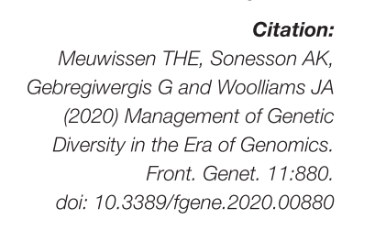
With IBS
Strictly additive traits
Further Reading
Measures of change in diversity from to a reference base
Model of gene/marker effects
e.g.
g = Wb
b ~ MVN(0,V_{b}I)
F_{IBD}
F_{drift}
F_{het}
F_{var}
Covariance of breeding values
i.e. relationships g_{ij}
F_{IBD}
F_{var}
Relationship matrices
e.g. Van Raden matrices
e.g. G₁
F_{drift}
F_{het}

Slide 46
Summary
Demonstrates
different perspectives of IBD & IBS models
different perspectives have consequences
both coherent
both reasonable in their own context

Slide 48
… Lecture 9 … Variances and Perspectives
Part 3: A quick look at reducing dimensionality

Slide 49
Predictors >> Data
An increasingly common problem
e.g. 100,000s markers, 1000’s phenotypes
‘omics data generates yet more 100,000s of expression data to fit the same ‘few’ phenotypes!
Options
shrinkage
reduce dimensionality
subset selection

Slide 50
Principal Components
Marker combinations with greatest variation
i.e. principal components
see handout
linear combinations of allele counts of all loci
orthogonal
ordered to have diminishing variance
‘directions’ that are most informative
best estimated
not necessarily most important for trait
Singular Value Decomposition of W matrix

Slide 51
How confident about the slope?
Narrow spread of x’s – small variance

Slide 52
How confident about the slope?
Wide spread of x’s – large variance

Slide 53
Two Covariates
Covariate B
Covariate A

Slide 54
Two dimensions
PC1
greatest variation

Slide 55
Two dimensions
PC2
orthogonal to previous
greatest variation

Slide 56
Principal Components
m = # markers
n = # individuals
Have minimum(m,n) components
Assume first t explain most variation in phenotypes!
i.e. as well as variation in markers
choose t < minimum (m,n)
by validation
Treat as random effects and approximate G
reduce computation
Fit as fixed effects

Slide 57
Partial Least Squares
Another procedure to reduce dimensionality
Uses (co)variances of y with covariates W₂
Set of components
c.f. Principal Components
Fit reduced number as fixed effects
All traits may not have same components!
PLS is a valued technique in some problems

Slide 58
Reducing Dimensions
Empirically fixed PC regression and PLS not as effective as shrinkage e.g. (e.g. G)
see Solberg et al. (2009)
Renewed can simplify computation of EBV treating PC as random and approximating G
i.e. shrinkage, but reduced dimensionality
for computational efficiency with huge data
Require all the SNP genotypes to obtain PC!

Slide 59
Subsets of Markers
Lasso
Bayes B … Lecture 10

Slide 60
Handouts
Optional
‘principal_components.pdf’
details now beyond the scope of the course
other things take their place!

Slide 62
…Lecture 9… Variances and Perspectives
Part 4: Factors affecting accuracy

Slide 63
Accuracy Criterion
Accuracy of evaluation,
Correlation of with where
is true breeding value
is estimate of breeding value from markers
What is needed to predict accuracy for a new species and trait?

Slide 64
Factors for Accuracy
Phenotypes
Genome Data
?
?
Methodology
Accuracy

Slide 65
Factors for Accuracy
Phenotypes
Genetic
Architecture
Population
Genome
Structure
Genome Data
Heritability
(h²)
Number
Markers
Number
Markers
(m)
Methodology
Methodology
Number
Records
(N)
Marker
Selection
Accuracy
Accuracy

Slide 66
Factors for Accuracy
Phenotypes
Genetic
Architecture
Population
Genome
Structure
Genome Data
Heritability
(h²)
Number
Markers
(m)
Methodology
Number
Records
(N)
Marker
Selection
Accuracy

Slide 67
Accuracy as f(h²,N)
Published formulae predict
c.f. shrinkage, amount of genetic information
h² richness/record, N number of records
~

Slide 68
Accuracy in Humans
Correlation with phenotype
Maximal accuracy
h² = 0.7
h² = 0.5
h² = 0.2
20% QTN included in markers. Simulated from HAPMA2 CEU human population
From Canela-Xandri et al. 2015

Slide 69
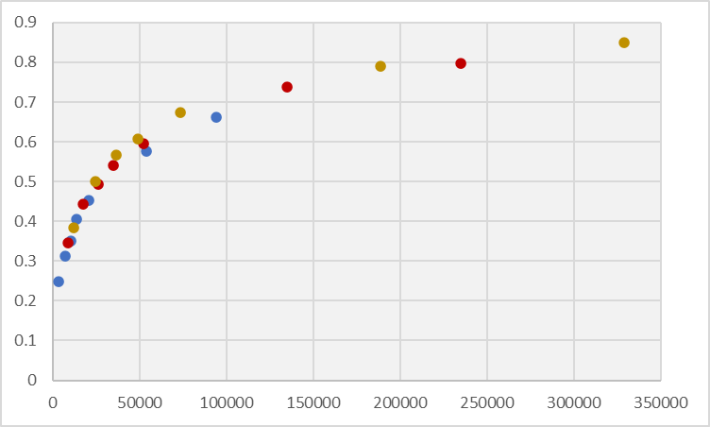
Accuracy & h²N
h² = 0.7
h² = 0.5
h² = 0.2
h²N

Slide 70
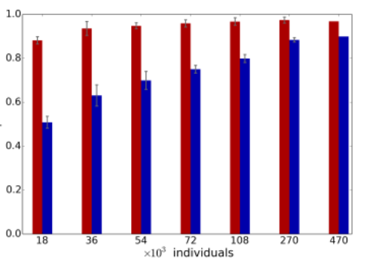
Information leads to GWAS
h² = 0.2, 20% of QTN genotyped, Ne very large
i.e. causal variants
1,000 QTN
10,000 QTN
Correlation of
with
for the 20%
470,000
Canela-Xandri et al. 2015

Slide 72

Factors for Accuracy
Phenotypes
Genetic
Architecture
Population
Genome
Structure
Genome Data
Heritability
(h²)
Number
Markers
(m)
Methodology
Number
Records
(N)
Marker
Selection
Accuracy

Slide 73
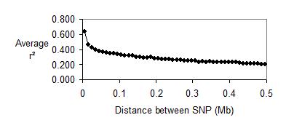
Same for all species?
Markers must capture genetic variation
must predict a nearby QTL genotypes
will depend on extent of LD
LD can extend relatively long distance
e.g. dogs, dairy cattle
… or short
e.g. humans
Equine population
Equine population (Ne=103)

Slide 74
Same for all species?
Define (approximately) ‘number of independent segments’, Me
Me ~ f(Ne, #chromosomes …)
c.f. number of beans in the bean bag
e.g. dogs Ne ~ 100, Me ~ 650
Equine population
Equine population (Ne=103)

Slide 75
Same for all species?
Consider ‘information per bean’ λ = h²N/Me

Slide 76
Same for all species?
Consider ‘information per bean’ λ = h²N/Me
Daetwyler et al. 2008, 2010

Slide 78
Factors for Accuracy
Phenotypes
Genetic
Architecture
Population
Genome
Structure
Genome Data
Heritability
(h²)
Number
Markers
(m)
Methodology
Number
Records
(N)
Marker
Selection
Accuracy

Slide 79
Factors
Accuracy,
where g(M) is the true ‘marker-accessible’ breeding value
i.e. EBV from unlimited data using the markers
is accuracy of EBV for g(M)
is genetic correlation of g(M) and g
if we have sequence

Slide 80
Marker Accessibility
An extreme example with
Q
Q
Q
M
M
M
M
M
M
‘Marker accessible’ variation
Q
Q
M
M
M
M
M
M
Q
Q
Q
Markers cannot capture this variation by linkage

Slide 81
How Much Variance?
Data from USDA genomic evaluations
net dairy merit
What is asymptotic accuracy?

Slide 82
How Much Variance?
Data from USDA genomic evaluations
net dairy merit
What is asymptotic accuracy?

Slide 83
How Much Variance?
Data from USDA genomic evaluation
net dairy merit
Daetwyler et al predict
i.e. a straight line
called ‘reliability’
‘α’ is 1/’fraction V_{g} captured’

Slide 84
How Much Variance?
Data from USDA genomic evaluation
net dairy merit
Daetwyler et al predict
i.e. a straight line
called ‘reliability’
‘α’ is 1/’fraction V_{g} captured’
Daetwyler et al. 2008, 2010

Slide 85
How Much Variance?
Data from USDA genomic evaluation
net dairy merit
Intercept 1.244
s.e. 0.053
Estimated ultimate = 0.80
s.e. 0.034

Slide 86
How Much Variance?
Data from USDA genomic evaluations
net dairy merit
Max accuracy ~ 0.9
up to 0.93
Attribute of a chip
expectation for a trait
traits will vary
e.g. if trait 1SNP on chip, r = 1

Slide 87
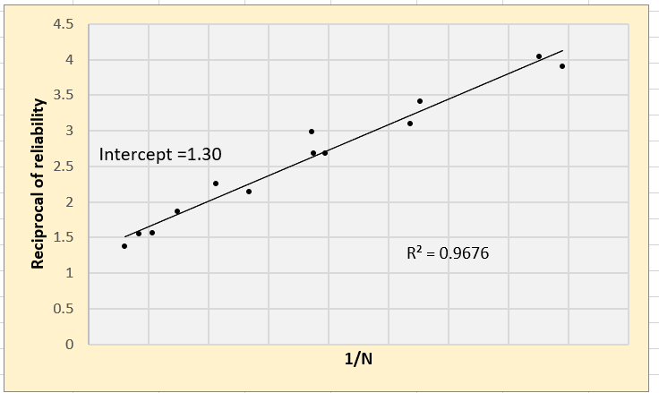
Canela-Xandri Simulations
Left-most 13 points,
avoid influence extreme right
Straight line is a good fit
Intercept 1.30
max accuracy =1/√1.3 ~ 0.88
Issues?

Slide 88
Canela-Xandri Simulations
Left-most 13 points,
avoid influence extreme right
Straight line is a good fit
Intercept 1.30
max accuracy =1/√1.3 ~ 0.88
Issues?

Slide 89
Canela-Xandri Simulations
Left-most 13 points,
avoid influence extreme right
Straight line is a good fit
Intercept 1.30
max accuracy =1/√1.3 ~ 0.88
Issues?
The earlier fit is affected by the assumption of max accuracy =1

Slide 90
Marker Accessibility
An extreme example
Q
Q
Q
We assume is high!
M
M
M
M
M
M
‘Marker accessible’ variation
Q
Q
M
M
M
M
M
M
Q
Q
Q
Markers cannot capture this variation by linkage

Slide 91
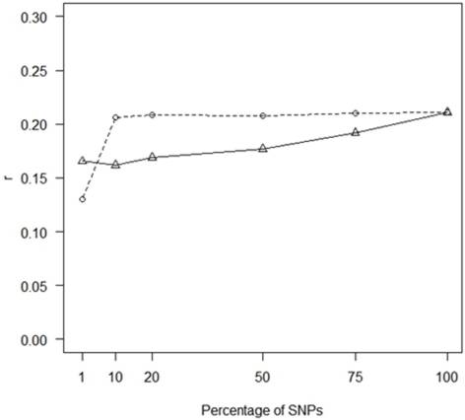
Accuracy as f(m)
Hip dysplasia in Labrador Retrievers
h² = 0.35
N_{e} ≈ 100
L ≈ 25M
N = 1179
m = 106,000
0.5
0.5
0.4
Random
0.4
0.3
0.3
Accuracy
(by cross-validation)
0.2
0.2
0.1
0.1
0.0
1
10
20
50
75
100
From Sanchez-Molano et al. 2015
% of SNPS

Slide 92
Accuracy as f(m)
Hip dysplasia in Labrador Retrievers
h² = 0.35
N_{e} ≈ 100
L ≈ 25M
N = 1179
m = 106,000
0.5
0.5
0.4
Random
0.4
0.3
0.3
Accuracy
(by cross-validation)
GWAS
0.2
0.2
0.1
0.1
0.0
1
10
20
50
75
100
From Sanchez-Molano et al. 2015
% of SNPS

Slide 93
Factors for Accuracy
?
Phenotypes
Genetic
Architecture
Population
Genome
Structure
Genome Data
Heritability
(h²)
Number
Markers
(m)
Methodology
Number
Records
(N)
Marker
Selection
Accuracy

Slide 95
Summary
Estimates on same data with different G (& A) may refer to different populations/conditions
compare objectively for subset s by scaling estimate by

Slide 96
Summary
Estimates on same data with different G (& A) may refer to different populations/conditions
Pedigree BLUP is a ridge regression on base A_{i} and descendent Mendelian sampling terms

Slide 97
Summary
Estimates from different G (or A) on same data may refer to different populations and/or conditions
Pedigree BLUP is a ridge regression on base A_{i} and descendent Mendelian sampling terms
Accuracy depends on information h², N, genome structure, marker number & choice

Slide 98
Summary
Estimates on same data with different G (& A) may refer to different populations/conditions
Pedigree BLUP is a ridge regression on base A_{i} and descendent Mendelian sampling terms
Accuracy depends on information h², N, genome structure, marker number & choice

